Slide 1

UNMB – Virtual Open Day for Incoming Students

Slide 2

Content
What is IN.TUNE?
Study in UNMB
Get to know the city
How to apply?
Student’s impressions

Slide 3
What is IN.TUNE?
The only European Alliance in music and arts, whose aim is to develop and assure the inter-institutional cooperation for promoting:
Education
Research
Innovation
Societal engagement

Slide 4

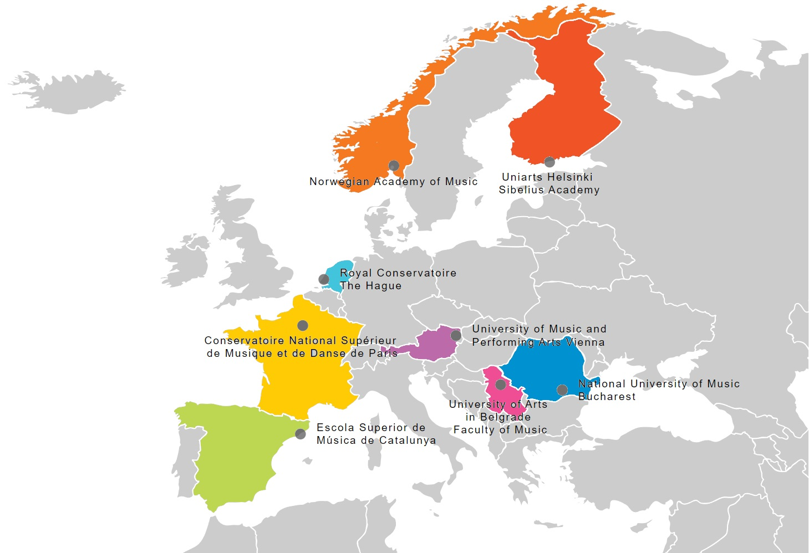

Who is IN.TUNE?
18 Associated Partners

Slide 5

Study in UNMB
The National University of Music Bucharest comprises two faculties, one dedicated to instrumental and vocal music performance, and the other to music theory.
In addition, five specialized centers explore areas such as early music, electronic and multimedia music, scientific and artistic research, and music information, with one center dedicated to the study of 19th-century music.
The five performance halls are multifunctional spaces where symphony concerts, chamber music recitals, opera performances, theater, film screenings, as well as workshops and symposiums can be organized.

Slide 6
Study in UNMB
The UNMB library also supports students, containing an impressive collection of teaching materials, books, scores, and manuscripts, while the media library offers an impressive number of audio and video recordings.
For a long time, UNMB has been facilitating students' access to internships, partnerships with renowned institutions in Romania and abroad, as well as projects dedicated to performance, creation, or research.
Very recently, UNMB launched Musical Jobs, the first and only Romanian platform dedicated to jobs and other opportunities in the field of music, which has already received positive feedback from students, graduates, and employers.
Take a look yourself: https://www.unmb.ro/en/campus/virtual-tour/

Slide 7
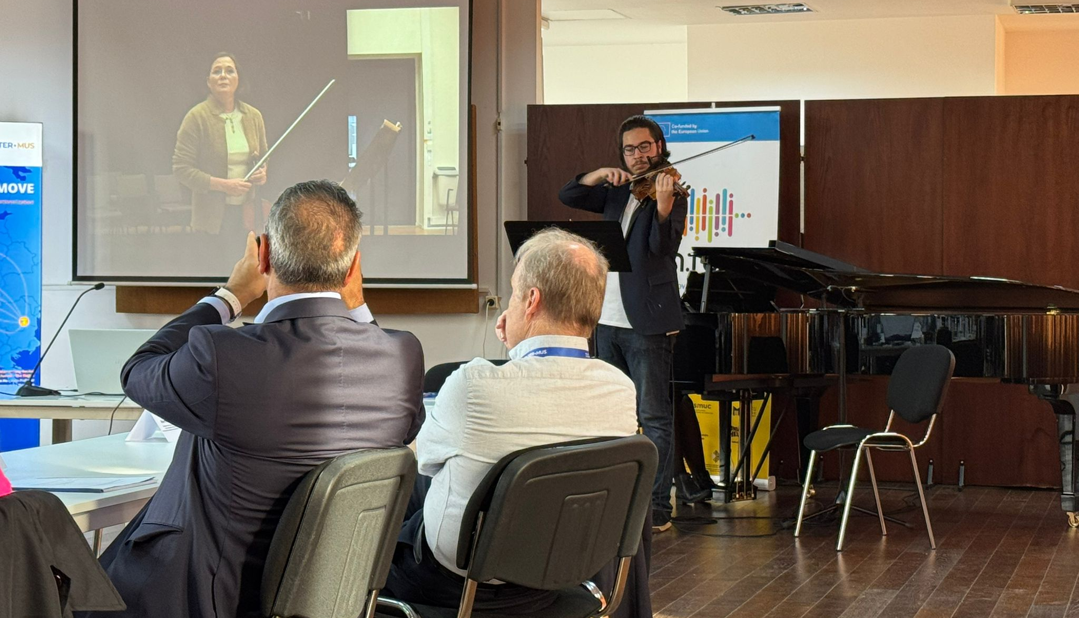
UNMB going Digital
Granted over 2 million euros from EU Commission for its digital improvement, UNMB has now a great infrastructure, with the latest-generation equipment.
High-speed internet
Two computer rooms (Windows and Apple) dedicated to teaching music production and technical editing, synthesizers, sound modules, Disklavier, etc.
Modern equipment for the main concert halls
Recording studios with excellent conditions for modern and experimental approaches in the field of electronic and electroacoustic music
Various interdisciplinary projects involving new technologies
MVTP low latency – system, purchased, tested and launched within the IN.TUNE Alliance

Slide 8
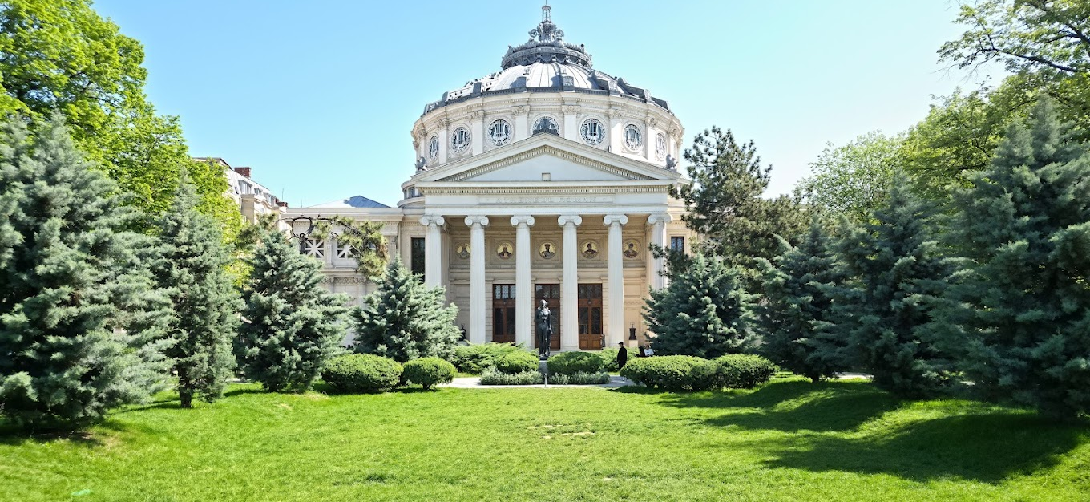
Get to know the city - Bucharest
Bucharest is a city that really lives through culture and music.
It is a place where classical traditions, contemporary creativity, and everyday student life naturally overlap.
Hosts the most important musical institutions in Romania, such as the Romanian Athenaeum, the National Opera House, and the Radio Concert Hall, as well as museums and cultural hubs.
Vivid artistic life: concerts, opera and ballet productions, jazz clubs, rock shows, experimental venues, museums, and festivals
UNMB student card allows free access to most concerts at the Romanian Athenaeum or the Radio Concert Hall.

Slide 9

George Enescu International Festival
One of the most important classical music festivals in Europe, taking place every two years,
World-class orchestras, conductors, soloists, and composers.
For students, an incredible opportunity to hear top-level performances, discover new repertoire, and feel part of an international musical community.

Slide 10
How to apply for an ERASMUS+ study place?
Step 3. Send the folder together with all your potential inquiries to the following email address angela.sindeli@unmb.ro
Step 4. Follow the deadline:
May 1st (for winter semester)
November 1st (for the summer semester)
Step 5. Application results will be communicated via email in max.1 month from the moment of receiving the complete application
Step 6. Confirmation – acceptance of the study place
Step 7. Learning Agreement - please check the following link for more details regarding the list of disciplines, corresponding to each study level.
Step 1. Contact your ERASMUS + office and express your interest in taking an ERASMUS + mobility for checking out the inner procedures of your institution.
We accept all the applications via EWP/Dashboard.
Step 2. Student Application Folder including:
Student Application Form
Europass CV
Recommendation letter(s)
Transcript of records (of previous studies)
Demo link (YouTube, VIMEO, etc.) for singers, instrumentalists and conductors, and a portfolio of works – for composers and musicologists.

Slide 11
Check more about…
Study programs https://www.unmb.ro/en/study-programmes/
Students’ housing https://www.unmb.ro/en/campus/the-student-hall-of-residence/
Students’ canteen https://www.unmb.ro/en/campus/restaurant/
Welcome week https://www.unmb.ro/en/international/erasmus/
Ask for a buddy to help you find your way in the UNMB community

Slide 12
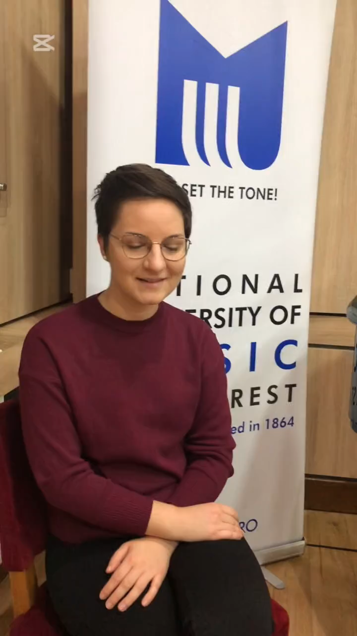
Students’ impressions
Isidora’s short interview before the ERASMUS+ concert
Isidora Vlašić – incoming students from UAB

Slide 13


Let’s stay in touch
For more information, please check:
UNMB’s website - www.unmb.ro
INTUNE Alliance’s website – www.intune-alliance.eu
For any inquiries, please reach out to angela.sindeli@unmb.ro

